Slide 1
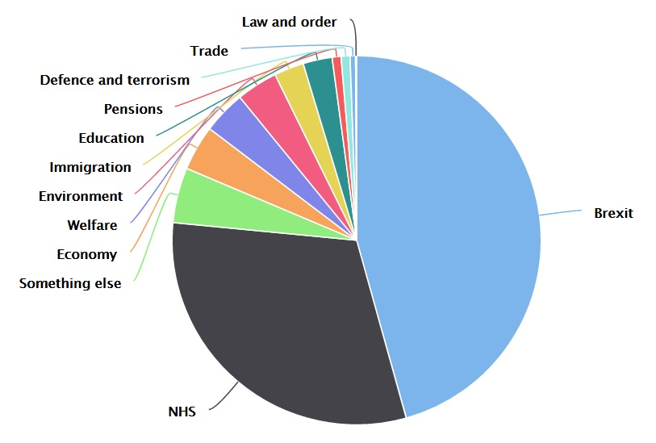
Campaigning on our top issues – like Brexit and the NHS
46%
31%

